Slide 1


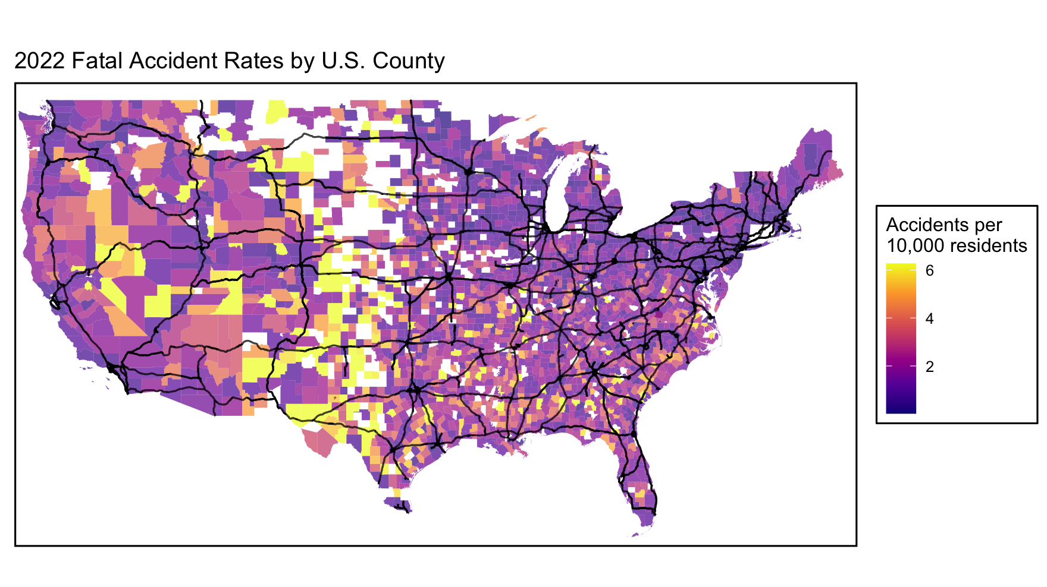
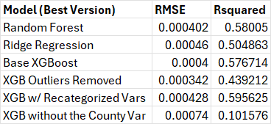
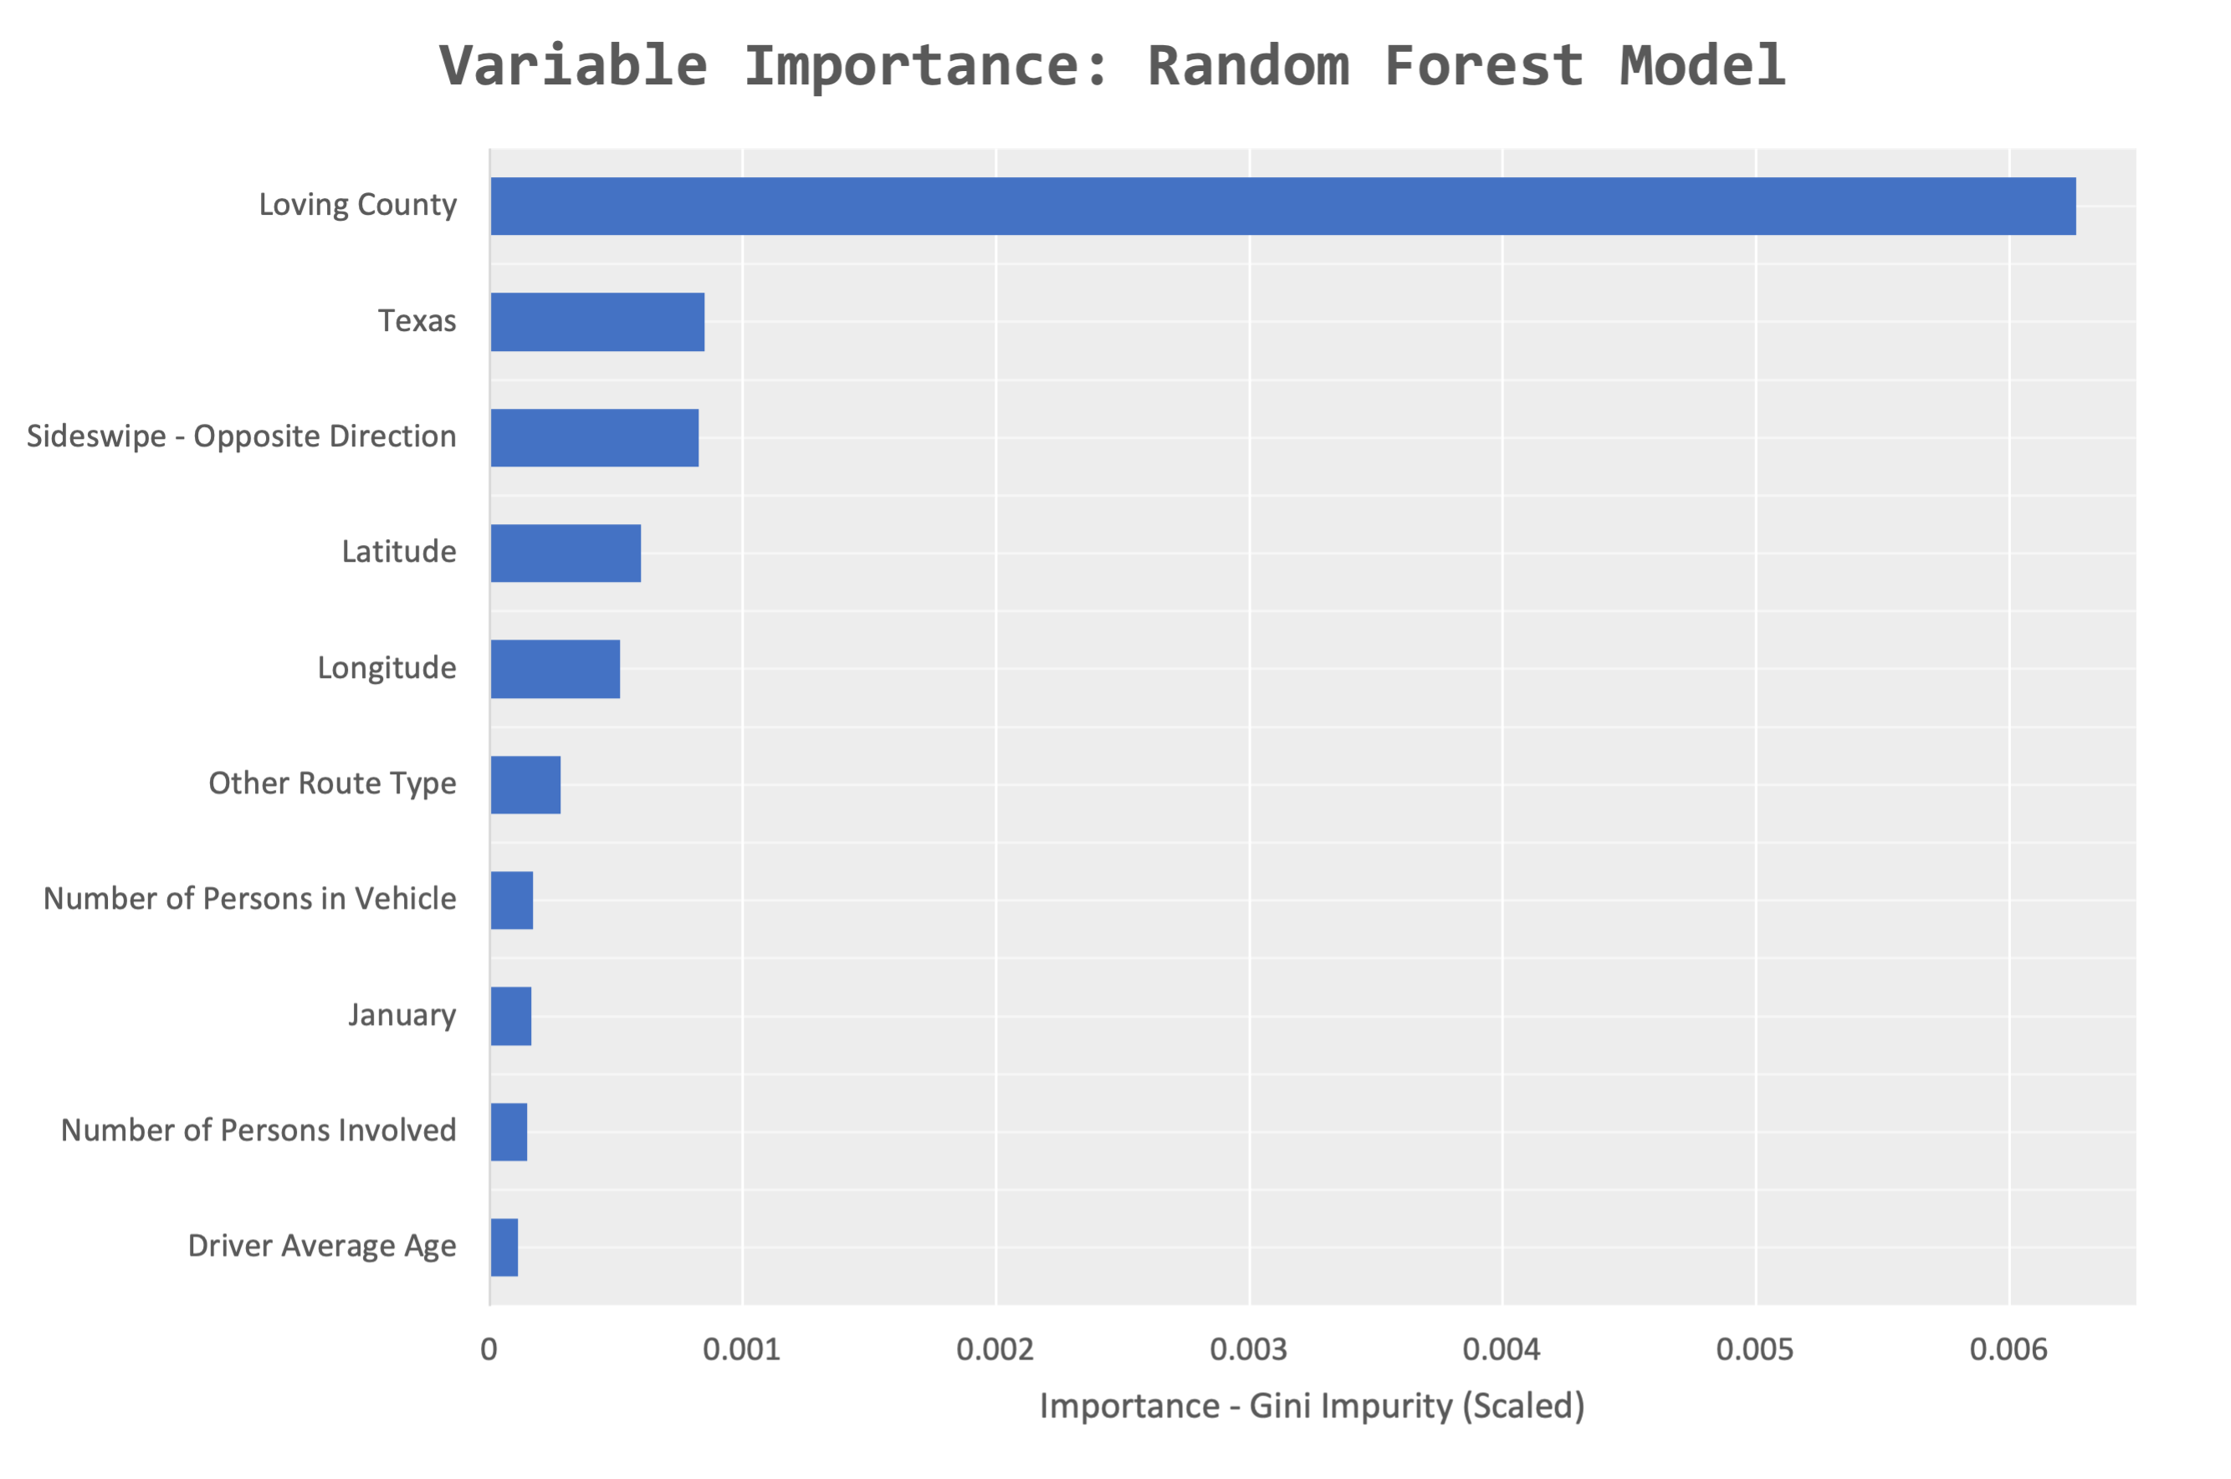
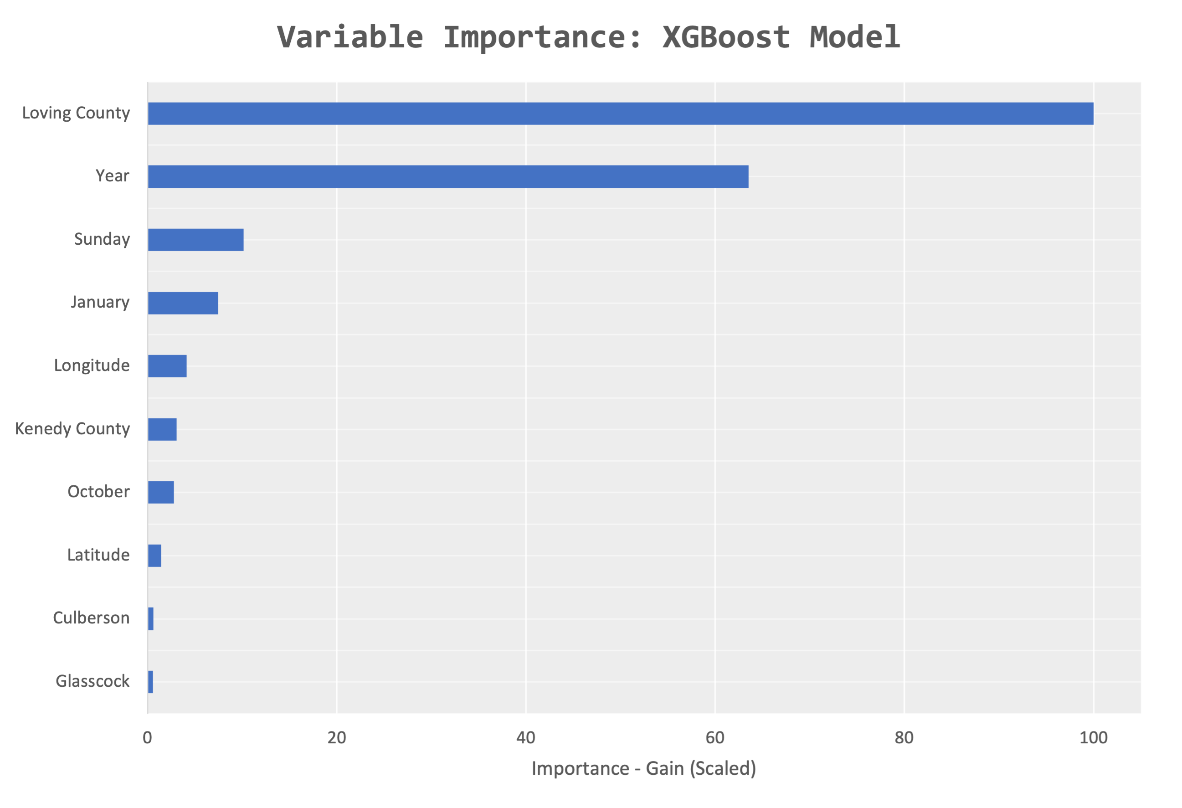



Fatal Forecast: Predicting and Analyzing Fatal Car Accidents
Neil Weingarten & Elizabeth Wile (MSDSA) – Graduating May 2025
INTRODUCTION
Advisor: Dr. Paul Johnson
RESULTS
Car accidents are an all-too-common occurrence, with many of us witnessing their aftermath on the way to work or school, or even experiencing close calls ourselves. The frequency of these incidents seems to be rising, making our roads increasingly hazardous. More than just an inconvenience, car accidents can have fatal consequences.
In this project, we aim to identify the most significant factors contributing to fatal car accidents in the U.S. and propose strategies to enhance road safety, ultimately reducing the number of fatalities.
When using the base variables with minimal transformation of the data, it was apparent that the Random Forest model was the best performing model when using the RMSE metric, outperforming the XGBoost and Ridge Regression models.
It was apparent that both the county variable alone and outliers present in the data influenced these machine learning models, as the removal of these individually had a tremendous impact on the model's R-squared and RMSE values. Furthermore, the refactorization of features appeared to bolster model performance.
Loving County, located in western Texas, had the largest impact on all models. This county had 2-4 fatal accidents per year with a projected population of about 100 people. Latitude and longitude, as well as the month of January, were also important in both models. In the Random Forest model, the manner of collision, the driver age, and the number of people present at the accident were also important factors. In the XGBoost model, the year the accident took place, and the month of October were important factors as well.
The hierarchical clustering method yielded uninterpretable results due to the high dimensionality of the data. Factor Analysis of Mixed Data (FAMD) was used to reduce the dimensionalty to a few factors, however the new factors only explained <10% of the variation in the data. These methods were abandoned due to the lack of meaningful results.
Understanding the analysis of the factors present within the machine learning models as well as their importance is crucial for creating plans to address problems with road safety in our country. It is apparent that certain areas in the country with lesser means of addressing their roadway problems are dealing with fatal motor vehicle accidents at a higher rate per capita. Local governments can provide support to these counties with less than ideal roadway conditions to improve traffic safety. Further research and development can be done to improve model accuracy and practical application, including:
Isolating categorical and quantitative variables present within the dataset and checking for factors such as multicollinearity between these variables
Considering alternative machine learning models to perform similar analyses
Performing other transformations of variables so that the methods that failed previously could succeed in producing meaningful results
Considering using fatal accidents per mile driven or per vehicle traveling through an area as opposed to a per capita metric for the target variable
METHODS
Data Collection
Yearly data were collected from the Fatality Analysis Reporting System (FARS) by the National Highway Traffic Safety Administration, which recorded all fatal motor vehicle accidents from 2018-2022.
Data Preprocessing: Original sample included 182,347 observations and 91 variables.
Performed median imputation on numeric variables for coded missing values and NAs, and mode imputation for categorical variables.
Removed redundant variables and variables with majority in one category.
Created variables to assist with the analysis, including but not limited to date, driver average age, season, and accidents per capita.
Merged Census Bureau data to obtain county population estimates.
Reduced the data to one observation per county per year with the estimated population and number of fatalities. This reduced dataset included 13,964 observations with 26 variables.
Data Visualization
Generated a map of fatal accident rates by county in 2022 using the R packages tigris, ggplot2, sf, and ggspatial.
Supervised Machine Learning Model Generation
Different types of machine learning models were created with the intent to create a regression model to predict the number of fatal accidents per capita across the country.
Several models were generated using the Random Forest method, XGBoost method, and Ridge Regression method.
The best tuned models were evaluated based off predictions the models gave to the test data and chosen with the intent to minimize the Root Mean Squared Error (RMSE) of the model.
The importance of each variable and factor in the model were analyzed and charted.
Unsupervised Methods
Cluster analysis was conducted with hierarchical clustering in effort to identify patterns or relationships among the variables in the data.
Factor Analysis of Mixed Data (FAMD) was used to reduce the dimensionalty of the data by creating new factors for variable groupings.
Table 1: Machine Learning Model Performance Based on Method and Considered Data
CONCLUSIONS
Figure 1: Variable Importance of Random Forest by Scaled Gini Impurity
Figure 2: Variable Importance of XGBoost by Scaled Gain
CONTACT INFO
Neil Weingarten
Elizabeth Wile

